Slide 1
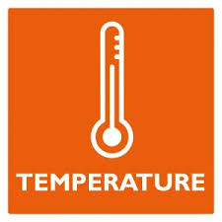

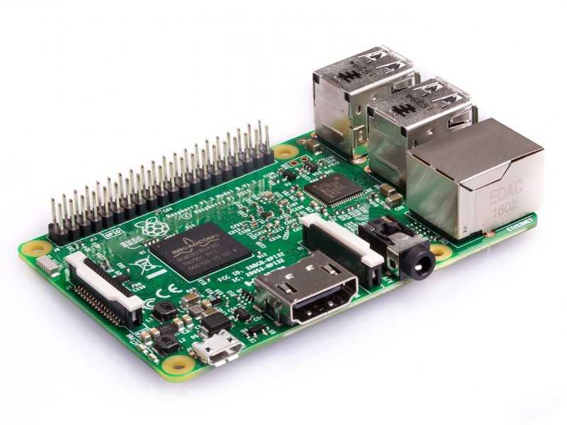

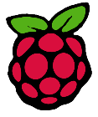

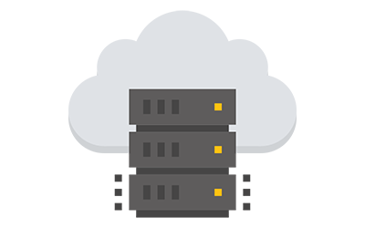

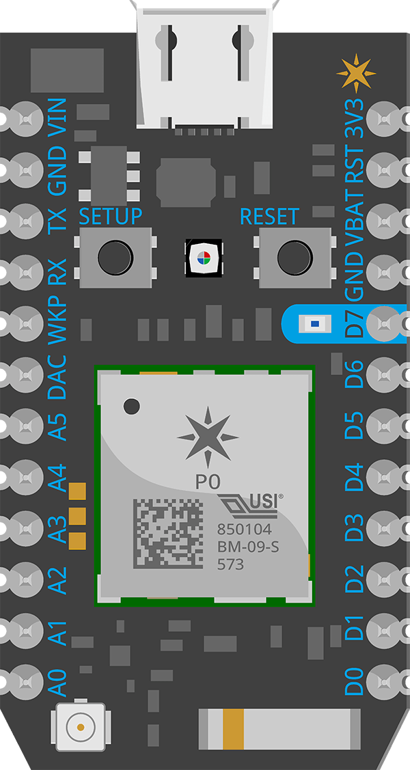



IOT System Architecture
// sensor communicates with controller through their own protocols like 1-Wire, SPI, I2C,..
Field Controller
// sever is setup over internet and manages data and host webs services
// Running python for data acquisition and sensor control
// https is used for web app communications
IOT Server
// client-server communication done using MQTT protocol
Sensors and Actuators
Field Controller
Web Monitoring & Control application

